Slide 1
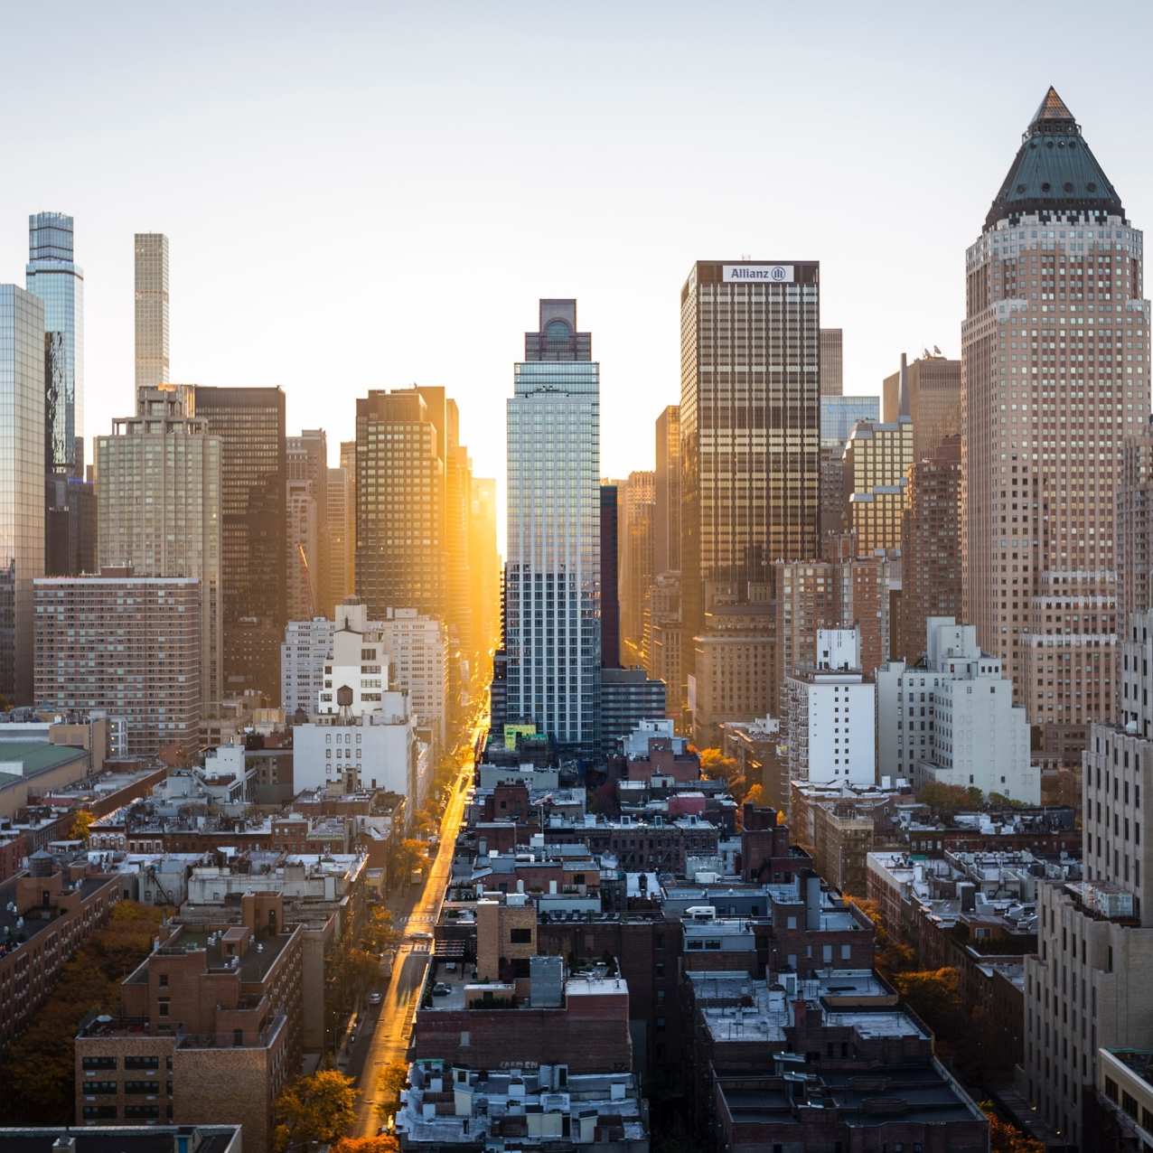
The capital project
Pitch deck v0.2

Slide 2
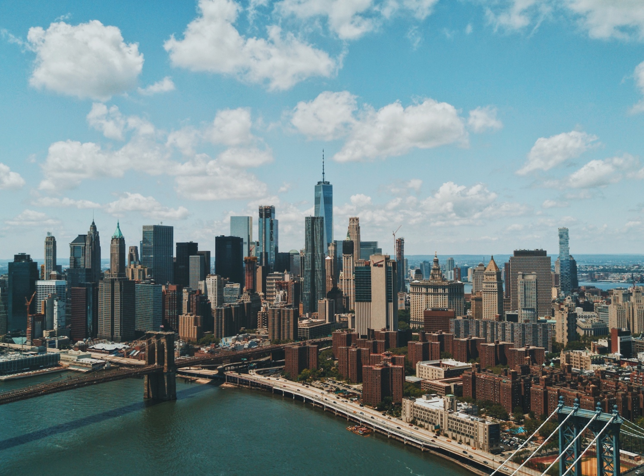
Background

Slide 3


Portfolio & work-life integration
Work & Career
Work-Life Integration
Portfolio
Home &
Family
Wellbeing &
Health
Portfolio career
Compilation of materials that exemplifies skills, abilities, qualifications, education, training and experiences.
A career that incorporates lots of different industries, roles, jobs, skills, and interests.
Skillset diversity
Innovation and experimentation
Personal branding
Broader experience range
Comprehensive services to clients
Community & Connecting

Slide 4

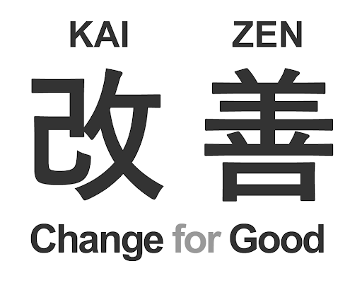
Kaizen: Continual Improvement
Kaizen
PDCA Cycle
Ongoing incremental improvement of processes, constantly evaluated to increase efficiency, effectiveness and flexibility.
Feedback: (self) reflection of processes.
Efficiency: identification, reduction, and elimination of suboptimal processes.
Evolution: incremental, continual steps
Plan: Identify opportunity and plan for change.
Do: Implement on small scale.
Check: Use data to analyze results and determine whether it made a difference.
Act: If successful, implement on wider scale and continuously assess results. If not, begin the cycle again.

Slide 5
Capital Breakdown
Intellectual Capital
Human Capital
Knowledge, skills, abilities
Experience
Entrepreneurial spirit
Flexibility, time management
Creativity & innovation
Attitude, mindset
Motivation
Relational Capital
Formal relationships
Informal relationships
Social networks
Partnerships
Alliances
Trust
Structural Capital
Organizational culture
Processes and routines
Formal processes
Informal routines
Management processes
Intellectual property
Brand
Data and information
Knowledge
Patents/copyrights

Slide 6
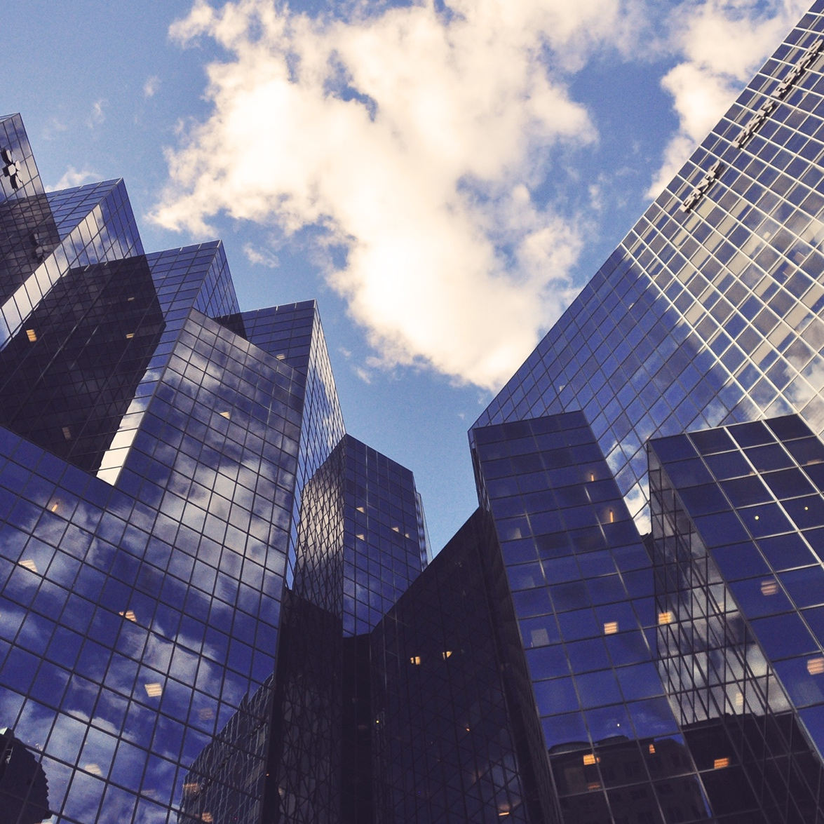
capital project
A capital project is a long-term project to build, improve, maintain, or develop capital asset that involves significant and consistent investment.
Characteristics:
large scale
costs a lot of money, management, resources
lasts a long time
generally extremely complex

Slide 7
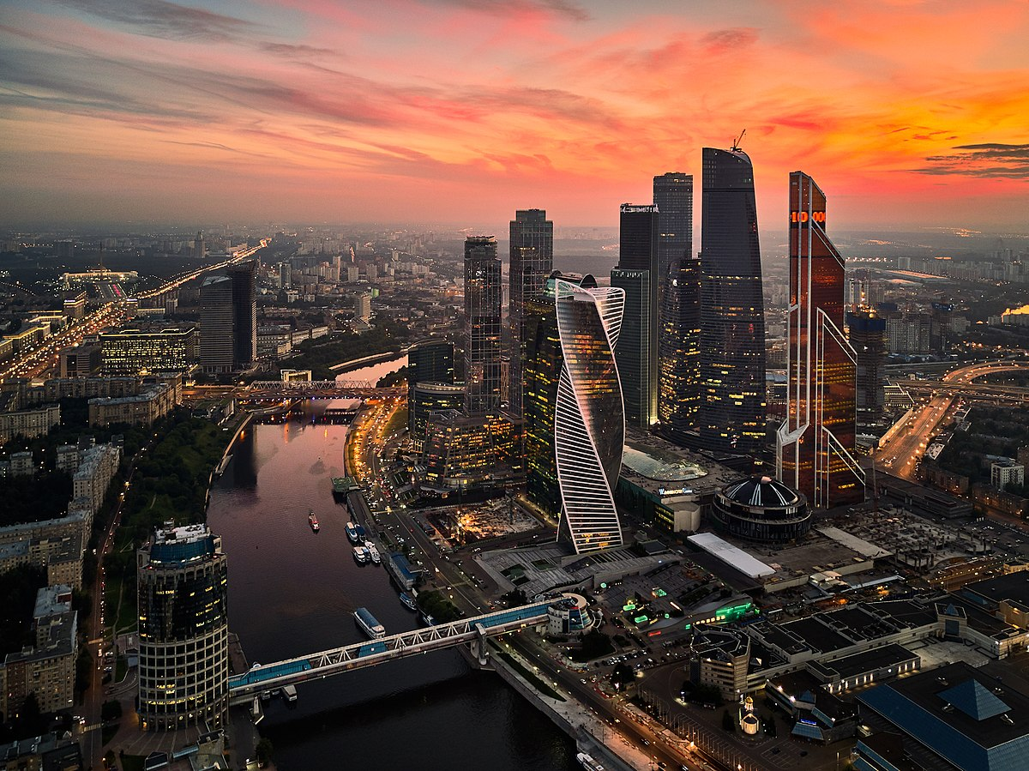
INTRODUCTION
to the Capital Project

Slide 8
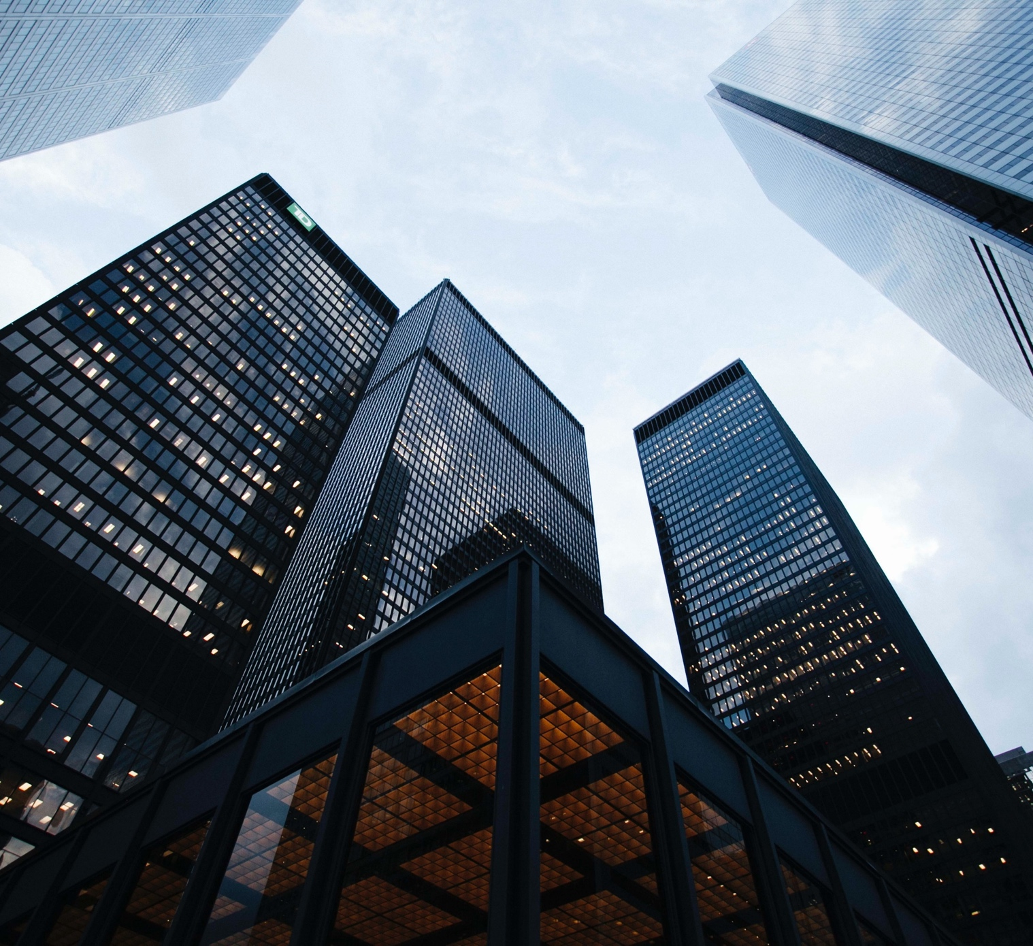
The capital project
“An online ecosystem that allows members to contribute in IT projects for community learning and improvement.”

Slide 9
Project
A series of tasks that is planned, designed, and executed to achieve a particular aim.
2 types of projects: solo project (designed and executed by 1 person) and group project (designed and executed by more than 1 person).
3 types of contributors:
A project is initiated by 1 or more customers. These customers are responsible to define the project requirements, project specification and deliverable expectations.
A project is executed by 1 or more creators (co-creators). They are responsible to design, create and finish the project based on the project requirements.
A project’s deliverable is tested and reviewed by consumers. Consumers can give score and feedback, pinpoint defects/errors, and give potential improvements or features to add in future releases.
A person can be customer, creator, and/or consumer in the same project.
A project should have deliverable in form of document, video, website, or product (software/hardware).
Examples of projects: creating a cooking tutorial video; designing an infographic about first aid; building a reminder mobile application; creating a short movie; building a house alarm system.
A project’s complexity level will be assessed and categorized.

Slide 10


systems
A system that defines how the Capital Project works, including citizenship, meetings, project execution and documentation.
Official members of the Capital Project is called citizens.
The central system is maintained and refined by citizens. Review is conducted at least once every cycle.
Portfolio Repository
A platform where contributors put all the working files and documents. It serves as file system, storage, version control, and archive.
Recommended platforms: Github, Sourcetree.
The Central System

Slide 11

Cycle
Cycle is a time unit used in the Capital Project. 1 cycle is a 6-month period (Jan - Jul, Jun - Dec).
A cycle meeting will be conducted every cycle to review the cycle and plan the next cycle.
Every cycle, each citizen should create cycle commitments and review his/her past cycle commitments.
Monthly meeting will be conducted every month to discuss cycle progress, ongoing and future projects.

Slide 12



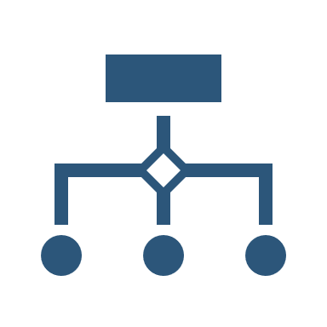



The Capital Project Ecosystem
The Capital Project Ecosystem
Portfolio Repository System
Cycle
Projects 1 Project 2 Project 3
Cycle Meetings
Cycle Commitments
The Central System
Monthly Meetings
Solo
Group
Solo
Contributions
Initiate & Define
Create & Execute
Test & Review

Slide 13

team
Bryan
GRACE
tba
tba
Citizen
Citizen
TBA
TBA

Slide 14

Thank you
capitalproject@email.com
http://www.capitalproject.com

